Slide 1
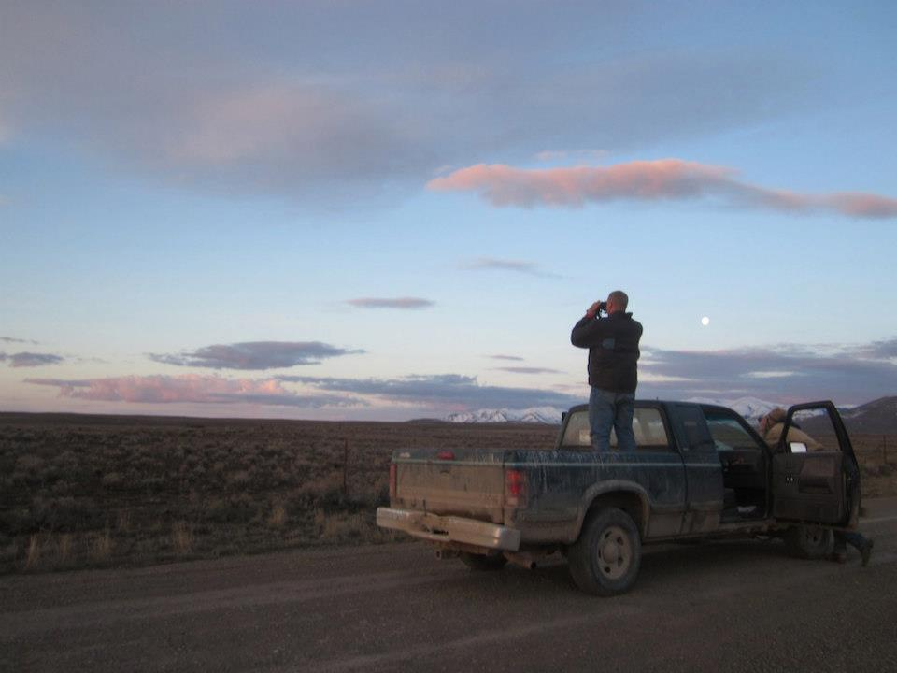

How to Write a Great Success Story
By Deborah Richie
SGI Communications Lead
info@sagegrouseinitiative.com

Slide 2
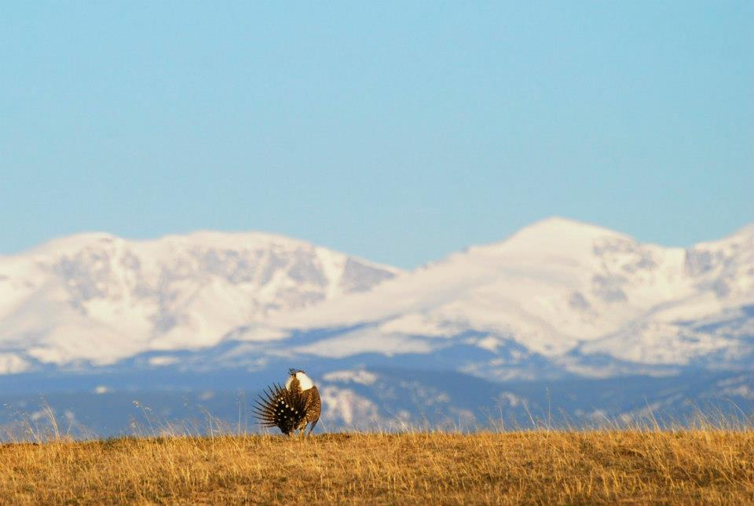
5 Easy Steps for Your Success
Choose your Story
Pitch your idea for publication
Do the Research
Write the First Draft
Finalize & Send it Off

Slide 3
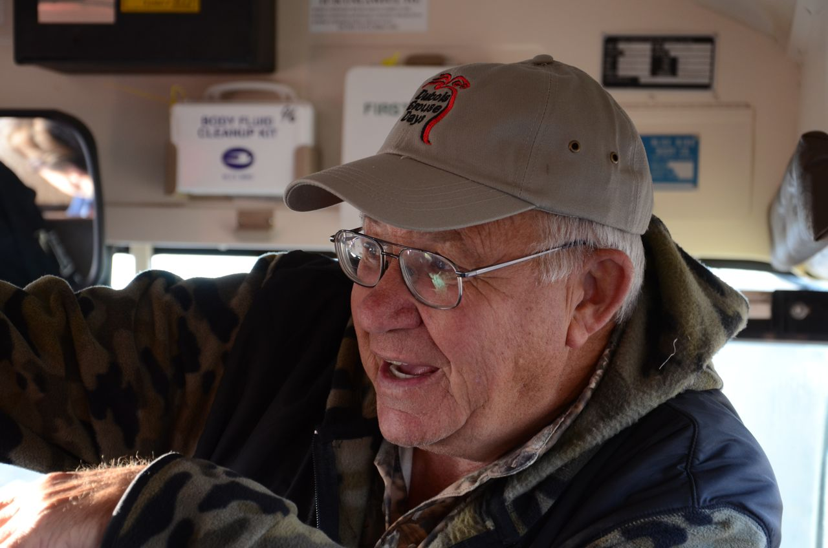
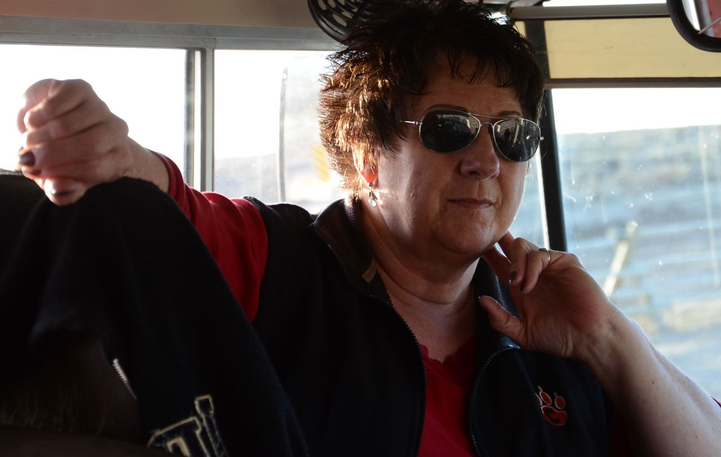
Step One: Choose Your Story
First: Identify your audience
Notes:
Start here—you’re writing locally—but you hope it will be picked up in more places. The audience is going to be rural, ranching, not necessarily familiar with SGI. You need to think what they care about. Is the species going to be listed? What would that do to the economy? Is there money that can come their way from being involved? Does SGI work? Why would it be good for my ranch? What is my neighbor doing? Remember, landowners talk to landowners and trust each other more than you.

Slide 4
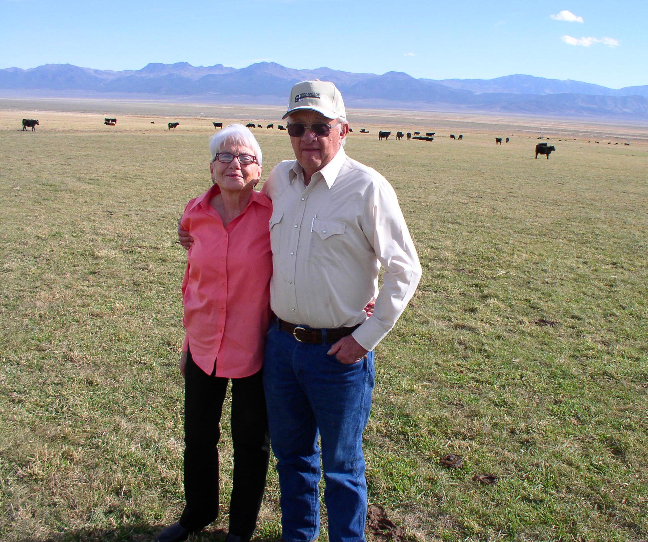
Make It Personal
Focus on
Local ranchers
or other SGI partners to
Tell the big
Story.
Notes:
You want to showcase success on the ground with a partner—likely with a landowner as a star. You want to tell the big picture story of what is happening locally through the lens of a real person from the community that people can relate to.
Most of you have worked in your communities with the landowners signed up for SGI for quite a while now. You have great contacts, partners, projects to report. So what’s the best story to tell? People care about—well people!
That’s who they may trust first. Also remember you are connected with the NRCS—longtime history there of trust and credibility. Use this.

Slide 5
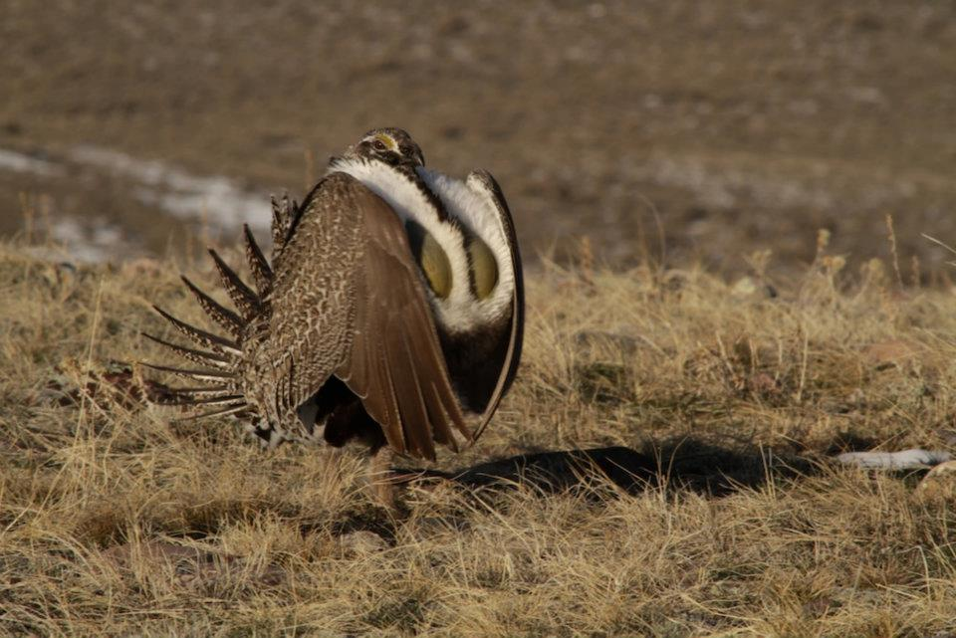
Sage Grouse- one sexy subject!
Be confident!
You have a very cool bird to feature!
Notes:
You have two great things going for a success story—first the local rancher perspective, and second the bird itself. Sage grouse are charismatic and will grab people’s attention.

Slide 6
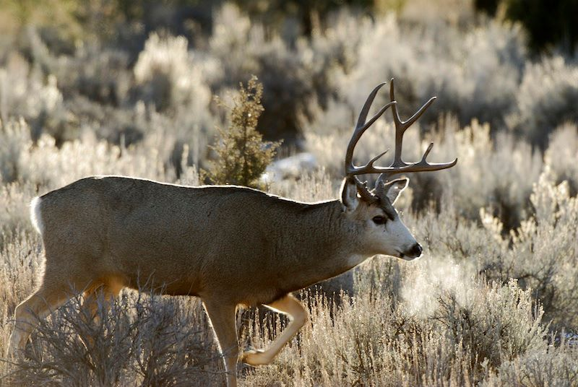
Plus Other Amazing Wildlife
Notes:
Remember to connect other wildlife people care about to your story, too. So you have people, sage grouse, and the mule deer, elk, and songbirds and more that fall under the umbrella of the sage grouse.

Slide 7
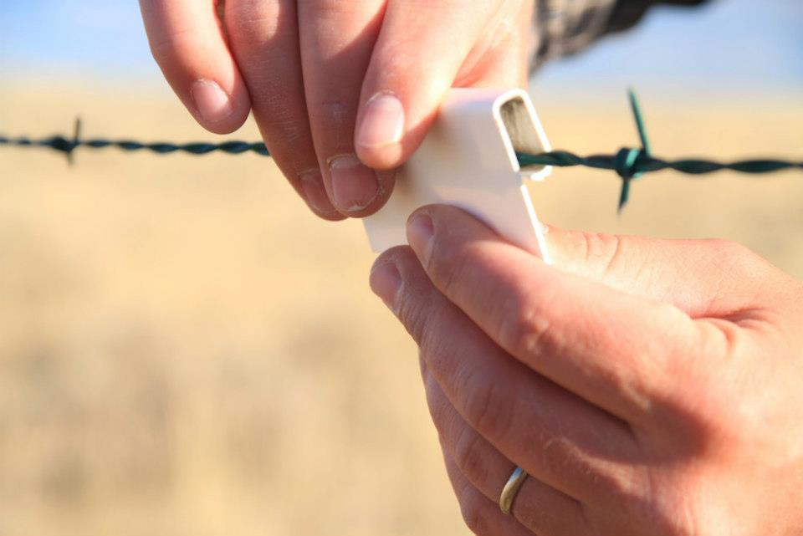
What’s the News?
Ex. Fence markers prevent grouse collisions
Now, find the hook
“I was headed out in the field
and the sage grouse took off and headed
right for that fence, but sure enough,
at the last minute they went up and over
those markers!”
Don Phillips
Notes:
What is the news that will grab your reader’s attention? The news hook ties to a larger message that informs people about the Sage Grouse Initiative – achieving conservation through sustainable ranching.
News Hook: Don and Sheila Phillips not only put up fence markers to prevent sage grouse collisions, Don saw firsthand a sage grouse avoid a fence because of the markers – an eye witness to a conservation success story that’s saving thousands of sage grouse lives rangewide annually, and is one part of SGI.
News Hook: Chris Black’s home ranch contains one of the last remaining pieces in the puzzle to connect the vast habitats that sage grouse require –and all it will take is removing the juniper trees

Slide 8
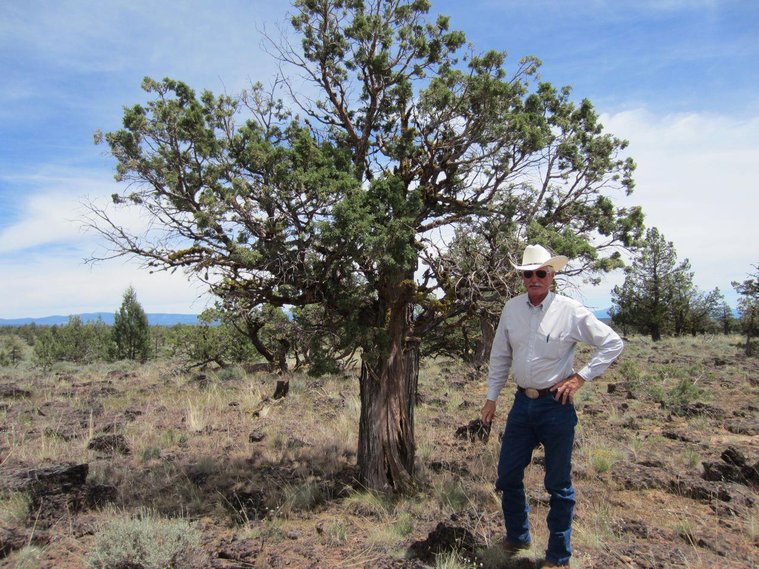
Step 2: Pitch (not ditch!) Your Idea
Jot down: the news, the hook, the approach (person or people featured).
Share internally first with NRCS PAS for your state & Deborah of SGI.
Contact your local
newspaper.
Notes:
Work with me (SGI Communications) and your state NRCS public affairs specialist to go over the story, and your angle, as well as places for publication.
Your state NRCS PAS is always looking for stories, and can publish them inhouse in newsletters, as well as put them out as news releases, to reach a larger audience, and use personal contacts as well.
Locally –call your local papers/ranch publications and let them know what you’d like to do. Best –phone call to check in/follow up with email/ stop in if you can to the office.

Slide 9
Pitch (Query) Example
For Western Livestock Journal:
Deborah Richie, Sage Grouse Initiative communications outreach,: Deborahwaite.richie@gmail.com
Story Proposal
In their Own Words:
Ranchers speak up about the Sage Grouse Initiative
Tule Lake and Alturas area California ranchers Mike Byrne, Ray Ackley, and Willy Hagge are voluntary participants in the Sage Grouse Initiative, receiving federal financial assistance to remove encroaching conifers that threaten both their ranching livelihood and sage grouse survival. All of them want to make sure they take positive action to prevent an endangered species listing.
I interviewed the three longtime ranchers by Skype this spring and on June 16, 17, and 18 I will head out into the field to see exactly what they are talking about on the ground. I’ll get their perspective on the challenges, the rewards, and their views of the lands they know like the back of their hands.
I’d like to capture their views of sage grouse, their long history with their ranches, and the Sage Grouse Initiative ( SGI dates to 2010 and funding comes from the Farm Bill—see www.sagegrouseinitiative.com) aimed at achieving wildlife conservation through sustainable ranching. I’ll be taking photos on the trip, gathering up firsthand impressions, jotting notes, and capturing the Sage Grouse Initiative on the ground. As a longtime professional journalist, I’ll take an objective look at the program and play a large role of the listener to ranchers – to find out about their challenges, what it’s like to run a ranch every day and make ends meet, and to get a clear picture of how SGI is working for them.
I look forward to discussing the upcoming trip . Thanks for your consideration of this article.
Notes:
I gave it a title that indicated the theme—ranchers speak up—in their own words.
I tell them who, what,where, when.
Followup: Ask if there’s something they are looking for.
Be prepared to explain the Sage Grouse Initiative briefly.
Give them your credentials. Why you are the one to write the story.

Slide 10
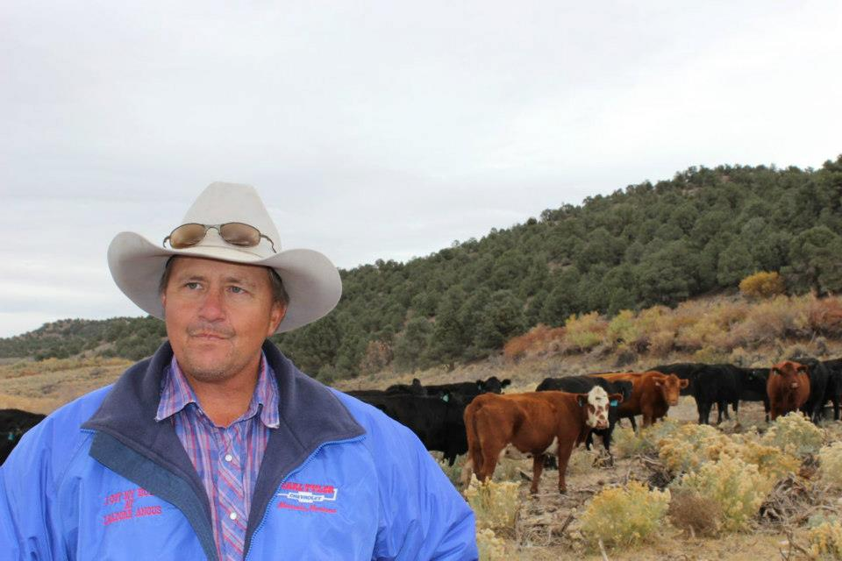
Step Three: Do the Research
Plan your field visit & interview
Notes:
Advance preparation – find out as much as you can/ jot down questions to ask
Notes—Make sure it’s a good time for the landowner, but also encourage a time that’s good for photography—morning or evening. Don’t be shy about the camera—let them know you need to take photos and will be snapping away as you go—some posed are fine, but try to get action shots on the ranch. Think light and photography. Try not to be taking photos at noon in the sun, so heading to the field in morning first is good and then sit around the kitchen table to follow up and clarify things.

Slide 11




What to Bring?
Notepad & pen(s), & maybe a
digital voice recorder
Camera (with video)
List of key questions
& reminder notes
Notes:
Notebook—small easy to carry is best—reporter style. Long and narrow. Extra pens!
Voice recorder—I put as optional. It can be great for capturing quotes and things that you missed in an interview. IT also means you have a lot of recording afterwards to sort through and you can end up with the danger of a too long quote. I use them on complex stories, however –like interviewing scientists. So you might want to try it. The other thing is maybe only use it on the kitchen table conversation, and not in the field. IF you do, set the person at ease—tell them you brought a recorder to get it right, and ask if they mind.
Camera with video—you may not use the video but I’m listing it, because I think we have opportunities to do some nice short recordings for a youtube station and I’d like for you to consider—a very short—1-2 minutes ---rancher talking about why they are in SGI, or what’s important to them.
List of key questions & reminder notes – I always do this! Prepare ahead. It is good to do the Who, What, Where, When, Why, how as a way to lead in. You want to cover all those bases when you write your story.

Slide 12
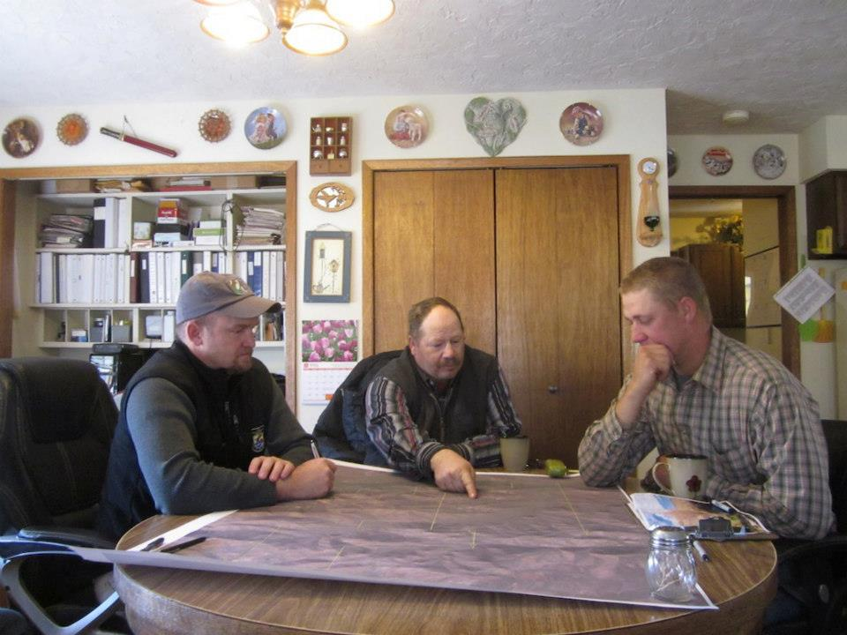
Interview Tips
Start with the weather-
Not the Endangered
Species Act.
Explain the story, who it’s for
& that you’ll be taking notes.
Some recording, & photos.
Use the “tell me more about
that” technique to go
beyond yes and no.
Jot down what’s interesting.
(not everything). Feel free to
ask to repeat or clarify.
Notes:
Refer to your questions and don’t be afraid to steer the conversation back toward what you want to know—while being open to new information you might not have planned on.
Make sure you get all names spelled correctly.
“Tell me more” example.
You ask: “Do you think the SGI program is helping your ranch?
He says. “Yes.”
You say, “Tell me more about that.

Slide 13
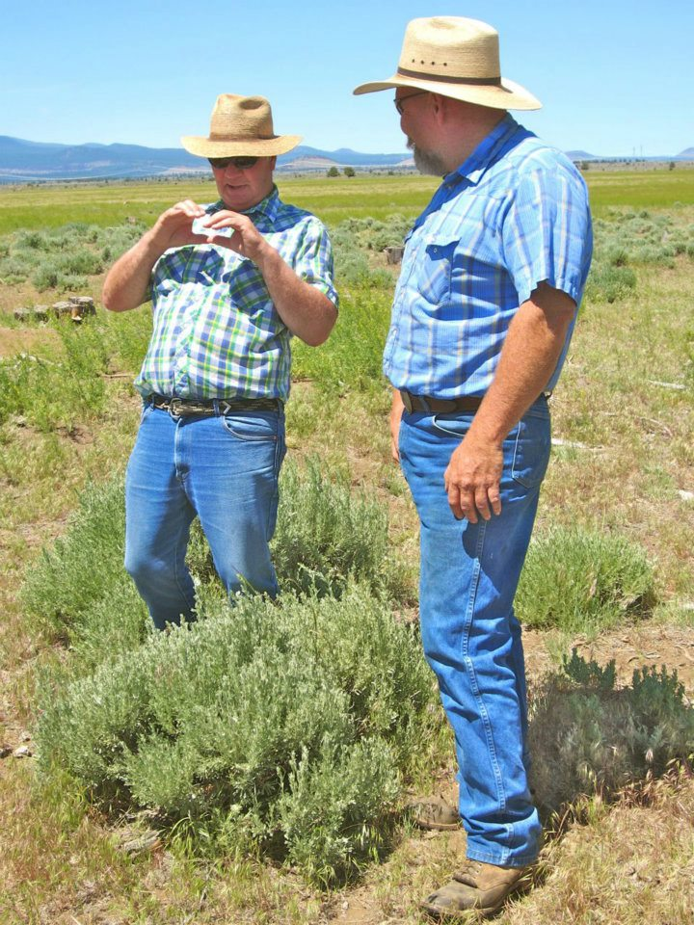
Photography Tips
Time of Day - morning/afternoon best
Action shots
Candid
Close-ups of
people, & of
small things.
Outside & inside
too.
Notes:
If you do have some ability to plan the timing—be outdoors in the field in morning or afternoon/evening when the light is best for photography.
Some posed photos are okay, but better to just get action shots that are candid.
Close-ups---don’t be afraid. Longer lenses that zoom help with this. Also—the small things can tell the story—like a rusty tractor in the field, or a butterfly on a wildflower.
I mention outside & inside, because sometimes I just use the photos later to remind me of details I might want to add when I write the story: “Gathered around the kitchen table, grandfather clock ticked steadily as it had probably for the last century here in this multi-generational ranch family.”

Slide 14
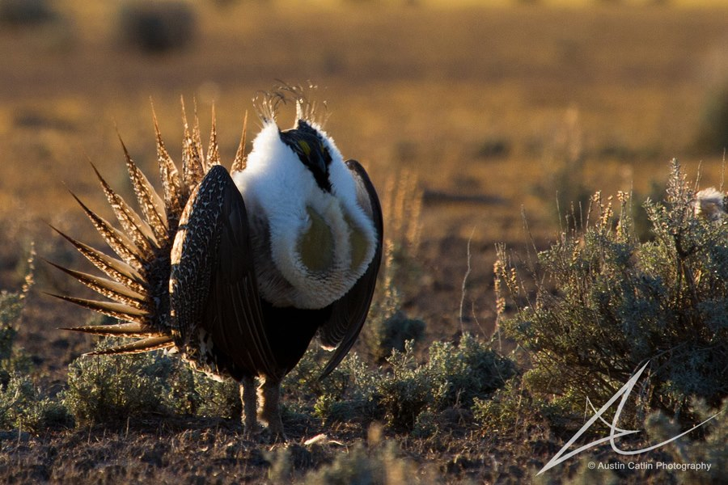
Step 4: Write A First Draft
Remember, it takes
grouse a few tries
too!
Notes:
So, you’re up to step 4 of 5 –you’ve chosen your story, you’ve pitched your idea and got the go ahead, you’ve done the research, and now you’re writing the first draft.
What to do? It doesn’t have to be perfect. It’s just a first draft. But it helps to be organized and to have gone through your notes, with your story in mind, and that story might be different from what you thought after the research and interview. Be open to possibilities. The first draft is usually too long and then you cut it back to the length you need to write in subsequent draft(s).

Slide 15
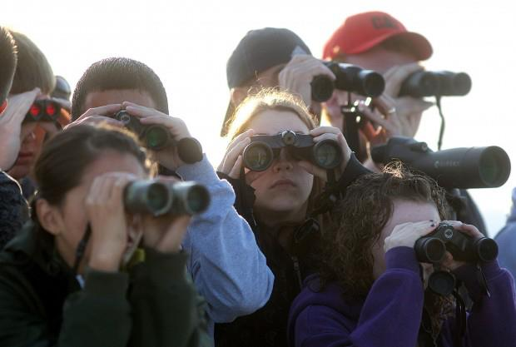
The So What? Test
Keep audience in mind. Will they care?
They will if your story is:
Enjoyable
Relevant
Organized
Thematic
Inspiring
Compelling
Notes:
Enjoyable: This is not a science paper with citations.
Relevant: Think about what your audience cares about. That’s the angle.
Organized—losing your reader is deadly—it has to eventually flow with a logical order.
Thematic -
Inspiring—we all hope for that—your subject can be the inspiration through the story and quotes.
Compelling—you want to keep reading.
Yes, that does spell EROTIC.

Slide 16
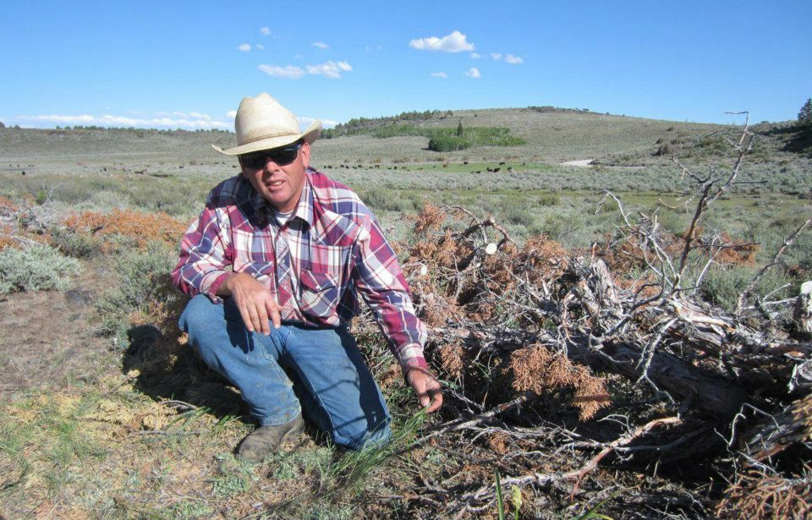
The Rough Outline
Beginning:
Hook to draw in reader.
Main message or news up high. SGI!
Middle:
Prove your point with examples.
End:
Good quote, or sentence that refers back to beginning.
Notes:
Avoid chronology—we went to the field, we did this, etc. Think how you read a newspaper—do you always flip the page to the inside spread? Those first couple paragraphs are critical—set scene, but also get in your main message.

Slide 17
What Makes A Great Quote?
Great: Evokes an image. Gives a personal perspective.
“We feel like this is a dream come true for us,” agreed Ray Baird.
“Our ranch has been in the family for more than a hundred years,” said Terry Clark. “We’d like to keep it together and not see it developed.”
Bad quote: A fact that doesn’t need quote marks. Does not sound like a real person. Too long (tape recording danger):
“The Sage Grouse Initiative is a highly targeted and science-based landscape approach to enhance and conserve rangelands for sage grouse,” said Tim Griffiths, SGI National Coordinator
Notes:
Notes –
If you look at your quotes and you want to clarify one, or ask again—feel free to call back your source and say that you wanted to check—and clarify, but don’t have them write a quote for you (won’t sound real).
About quotes—try to be as accurate as possible but don’t worry about little words like the, but, also..
Don’t be afraid to ask again..(during interview and for a call back).
“Let me get this straight—I think you are saying…?”
Afterwards, highlight the main points and quotes you might want to use.

Slide 18
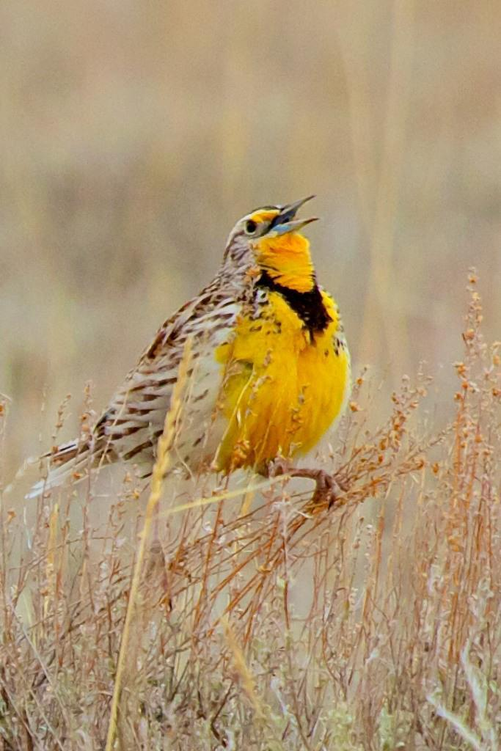
Writing Tip #1
Prose that Sings!
Avoid bureaucratic jargon words.
  Carry out, instead of implement
  Rancher, instead of producer
  Juniper invasion or spread, instead of encroachment
  Sagebrush dependent wildlife, not obligates

Slide 19
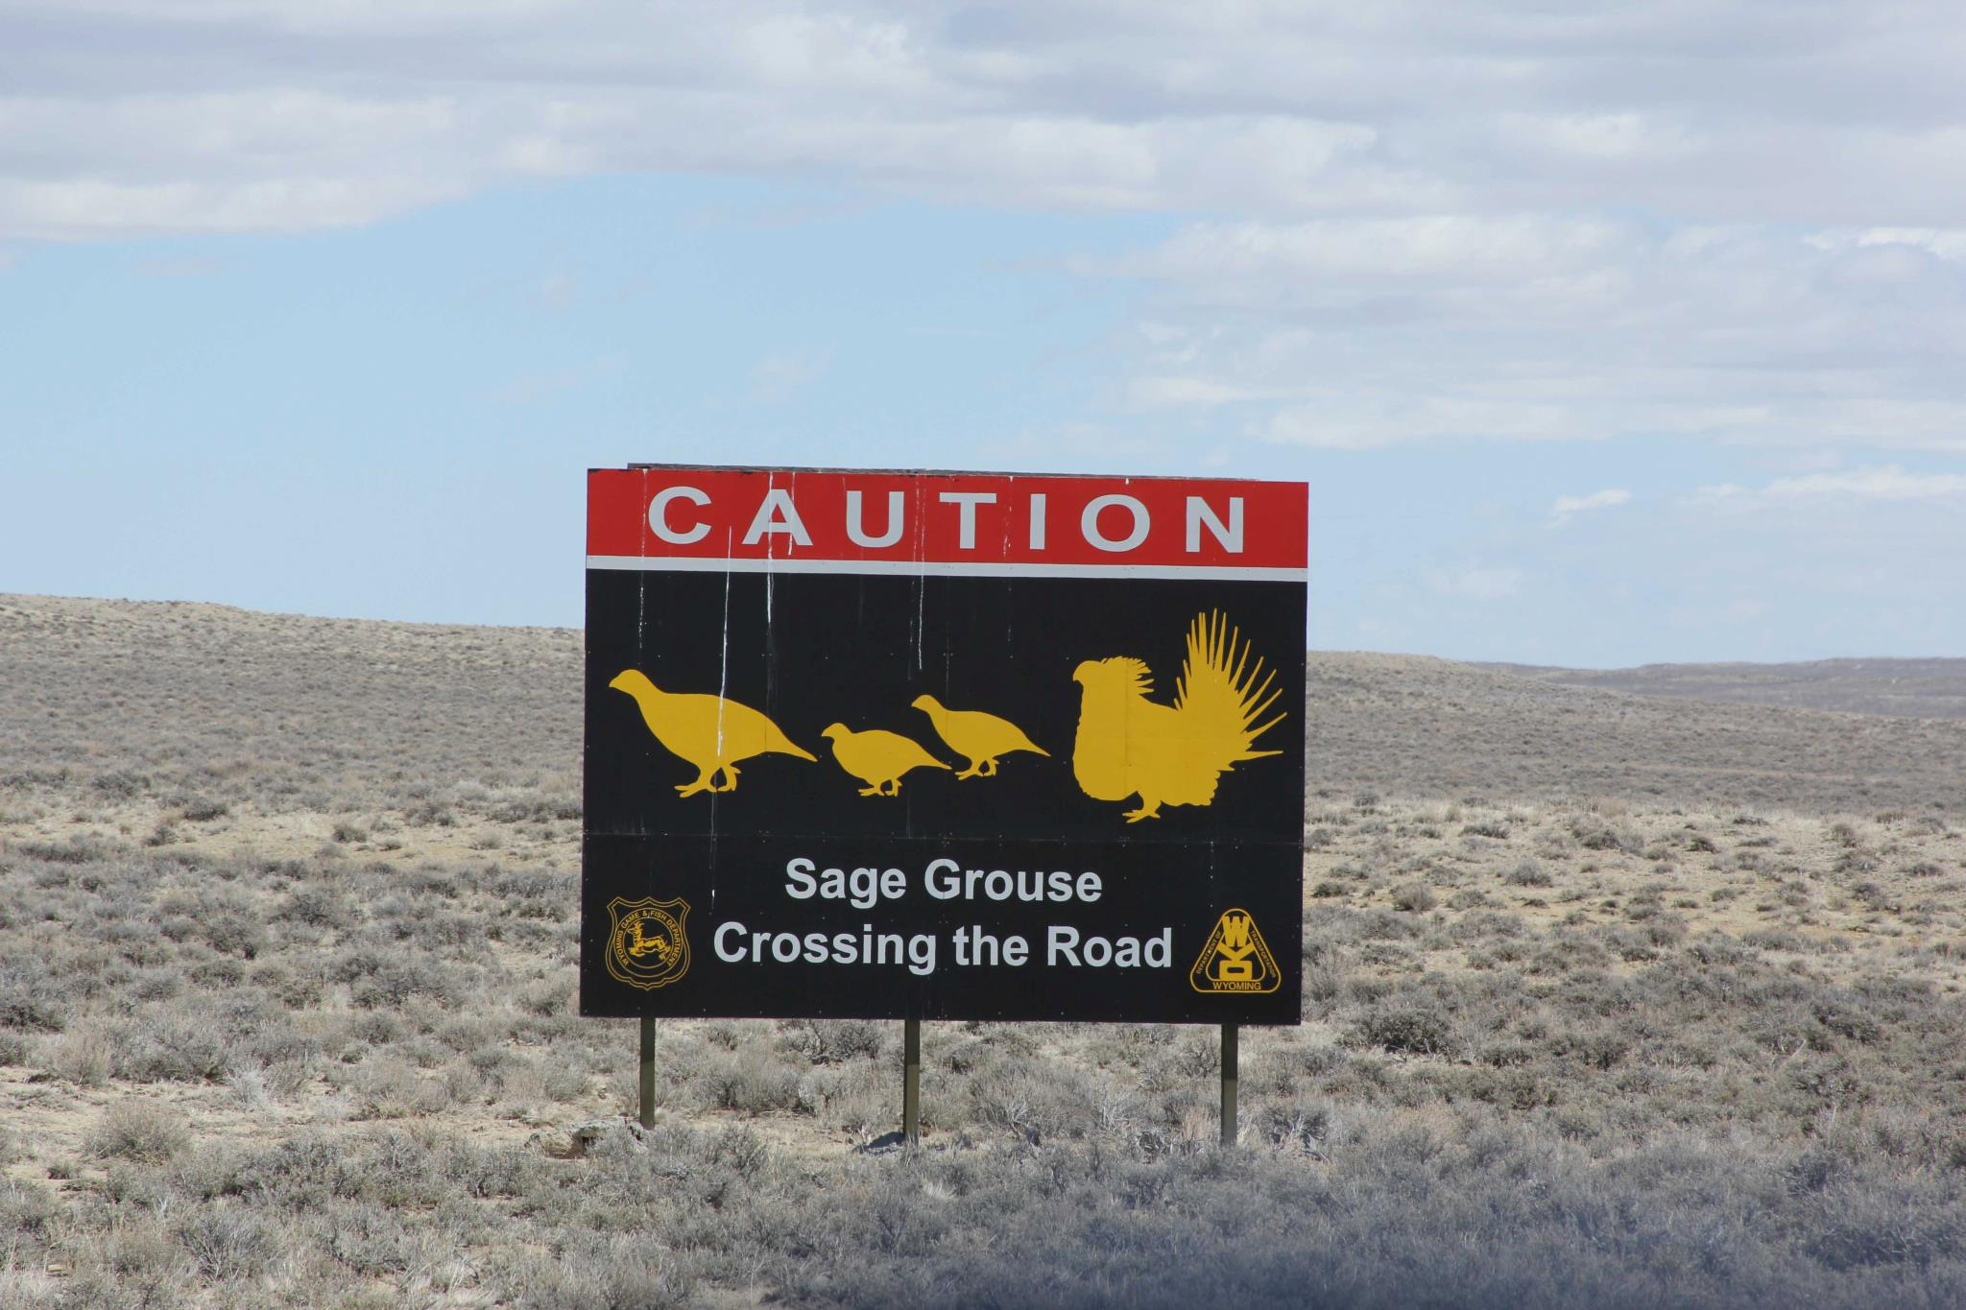
Writing Tip #2
Say it shorter. Avoid long sentences & extra words.
  Short: Don and Sheila Phillips own and operate the Steptoe Valley Ranch near Ely.
  Too wordy: Local cattle ranchers, Don and Sheila Phillips of Ely, Nevada, are the owners and operators of the Steptoe Valley Ranch and have been in the cattle business for several years.
Keep your reader’s attention!

Slide 20
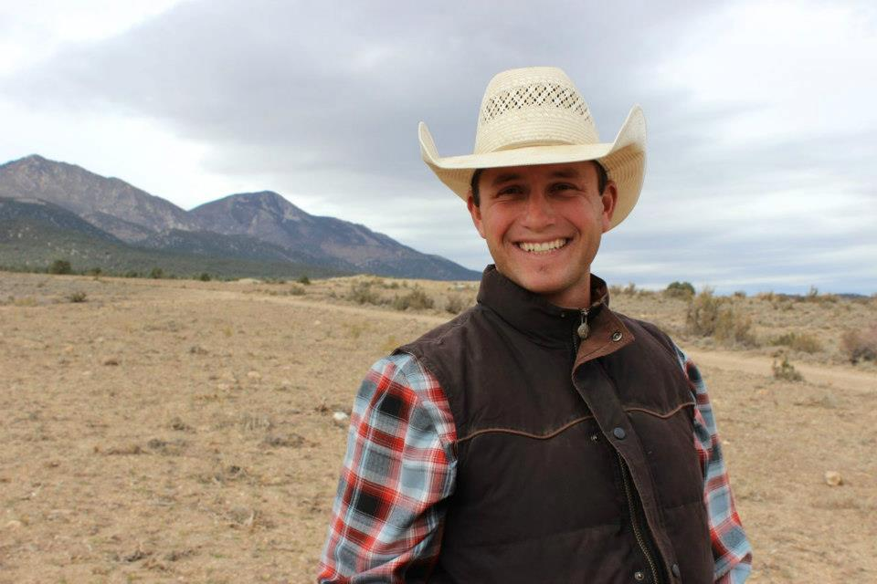
Step Five: Finalize (& Send)
Read out loud – for flow, making sense. Try it on a co-worker.
Check accuracy - names, facts, dates.
Length. Shorter is better.
“The Sage Grouse Initiative
helps our family stay in ranching,”
said Bryson Masini.
“It helps us and it helps the birds.”

Slide 21
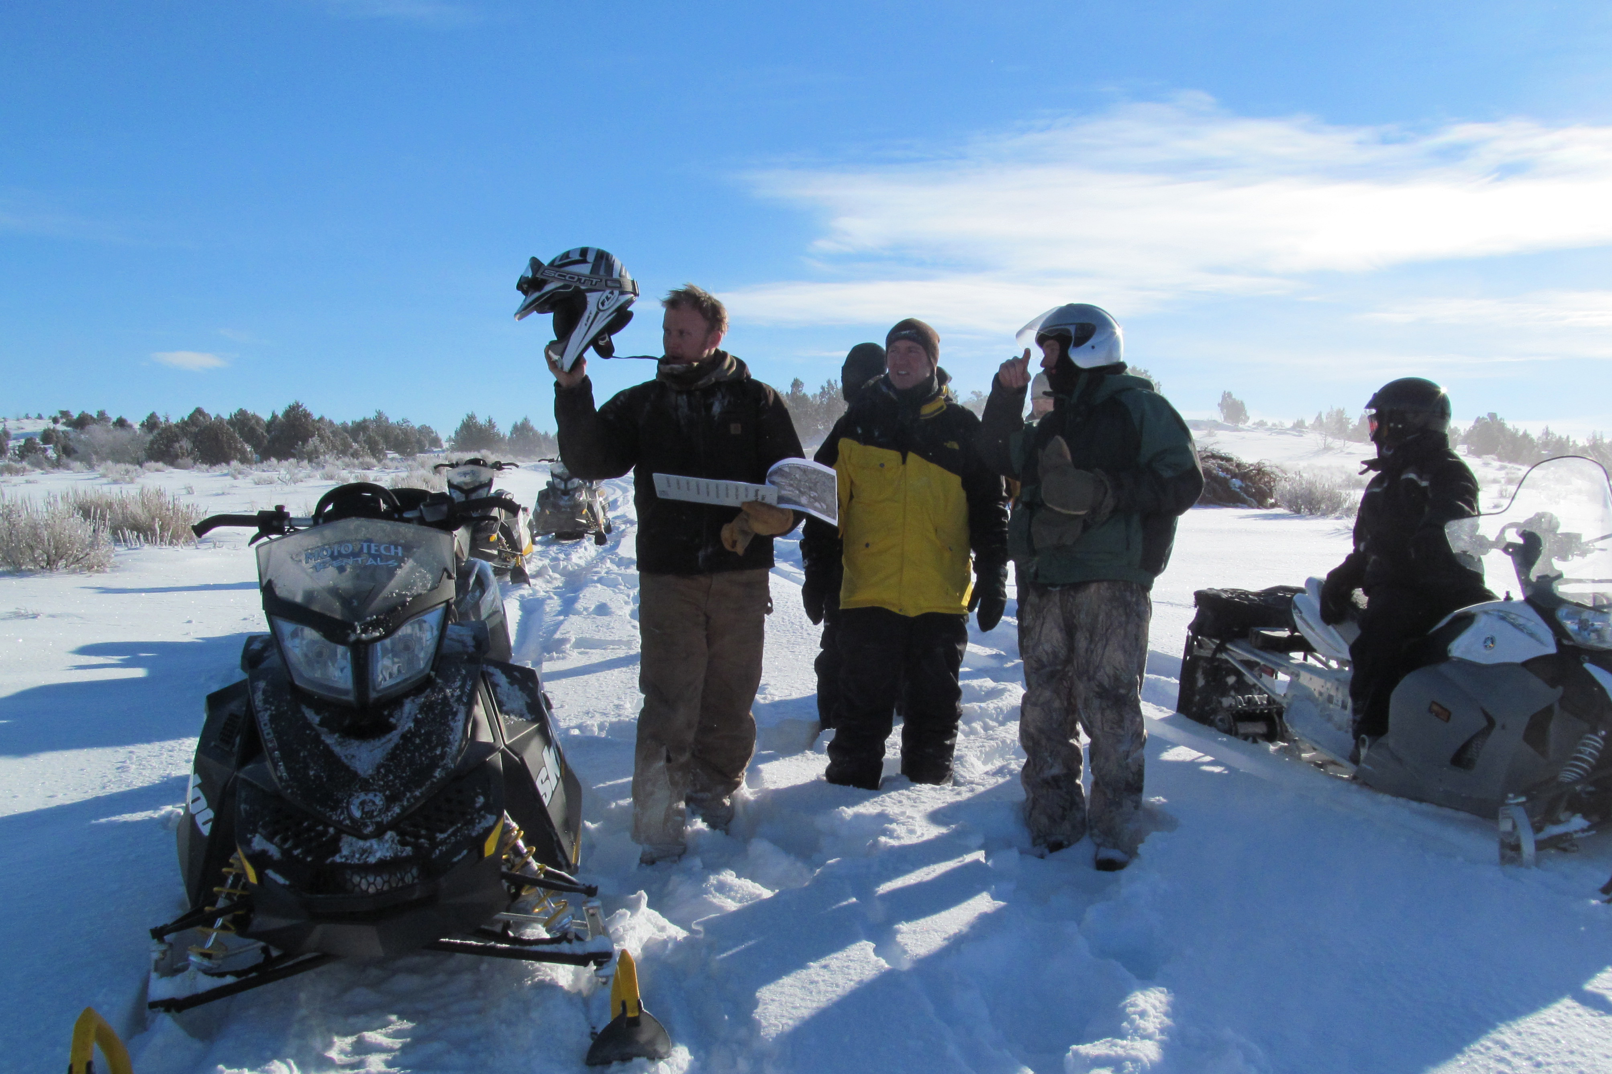
Final Touches & Send it Off
Run your piece by your NRCS Public Affairs Specialist, and Deborah. Make final changes.
Format: Simple word document. Separate photo attachments as jpegs. Do NOT do your own layout.
Include photo captions.
Identify people. Photographer.
Notes:
Note- We can help you with the final look for sending too- you definitely need your name at the top, who it’s for, the date, and the word count. Put a suggested headline that conveys the story. Recognize the editor will put on their own headline, normally. Photo notes– check in with PAS, or others on size---usually 1 MB is plenty big enough, but always err on the side of higher resolution rather than lower. Make sure you’ve included photo captions.

Slide 22
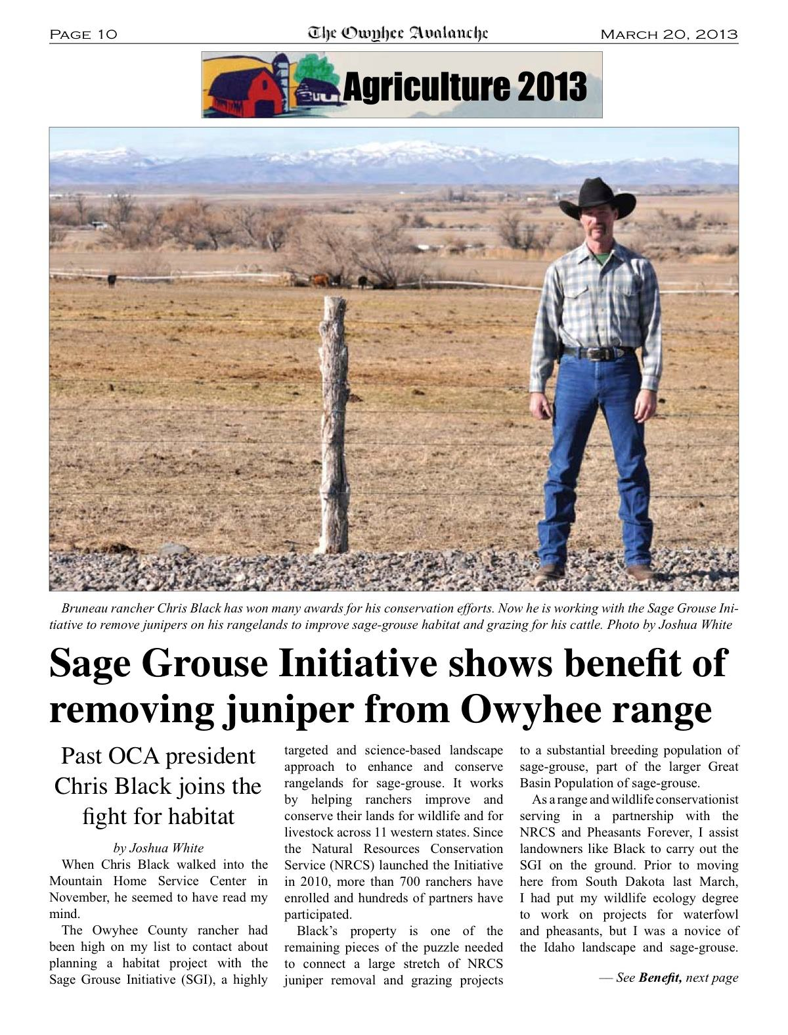
Your Article Appears: Success!
Notes:
Note: As Josh and Scott can tell you, your article will likely appear in more than one publication—multiplying the benefit. Why? That’s the great connection with NRCS PAS. They will likely put it up on their website, and then put it out in press release form and use personal contacts for more publications, including magazines. It works! Just ask Josh and Scott!

Slide 23
SGI Story Template
Contact: (list your name and phone number)
Sage Grouse Initiative in _____X County: Wildlife Conservation Through Sustainable Ranching
In __County, ___(state), landowner (or rancher) _____ has stepped up to proactively conserve sage grouse, a western species that has dwindled in numbers from as many as 16 million to some 200, 000 and inhabits half its historic range. In __(your area), populations face (name key threats and status).
(Add quote from landowner here about why he/she has stepped up. Example: “I’m getting the help I need to keep my ranch in the black, and at the same time the work is doing a world of good for sage grouse here.”)
X (landowner) is enrolled in the Sage Grouse Initiative (SGI), a partnership of the NRCS many groups. What’s good for grouse is good for rangelands defines a shared vision with positive results pouring in from 11 western states.
The Natural Resources Conservation Service launched SGI in 2010, after the sage grouse became a candidate species for listing under the Endangered Species Act. The U.S. Fish and Wildlife Service has delayed final consideration of listing until 2015, offering a window of time for SGI to take a voluntary approach for recovery that benefits agriculture and sage grouse, along with a suite of other wildlife.
SGI harnesses the power of the Farm Bill to strategically focus budgets and partner matches where habitats are intact and sage grouse numbers are highest. While private lands are the primary focus, the Initiative serves as a catalyst for public land conservation, too.
Here in _X (area), X (landowner) is (describe conservation action, partners).
X’ s (landowner) projects for sage grouse and healthy rangelands put a face on the overall numbers that together are making a difference range wide. To date, 700 + ranchers are enrolled in SGI. Conservation easements have reduced sodbusting and subdivision threat on 240,000+ acres. New grazing systems are increasing hiding cover for nesting birds on 2+ million acres. Removing invading conifers has restored historic sagebrush-steppe on 200,000 acres. Marking or removing 500+ miles of high-risk fences has saved thousands of birds from deadly collisions.
Here in X, (add #s).
To find out how you can be part of the success, please contact X (local contact).
Notes:
I’m not going to talk about this one here—just for your reference—feel free to copy it and start plugging in your info for a quick story.

Slide 24
Bonus: 9 Tips on Talking to the Press
Cultivate reporters. Help them learn.
Provide them with materials & contacts.
Use talking points – 3-5 main points.
Repeat key messages.
Offer clear examples.
Don’t speculate—you’re always on the record.
Take your time & be concise—remember they’re taking notes.
Be friendly, courteous, and helpful.
Think field trips, good visuals, events of interest.

Slide 25
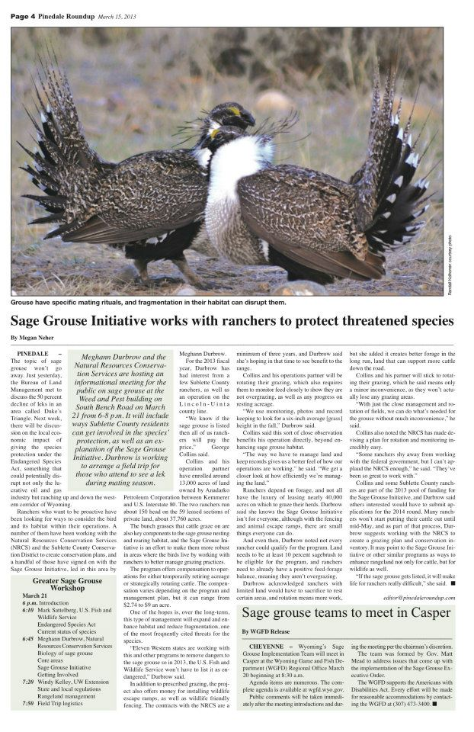
Pinedale Newspaper Example
Notes:
This is the story Meghan Durbrow worked on with a newspaper reporter. She could share at some point the trials and tribulations—and there are things in this story that aren’t accurate. But give the reporter more time and another story and keep it going. It will get better. Recognize they rarely let you see the story ahead of time. So you have to just provide the key information—and if some of it should be in writing to them as a followup—do that—SGI main talking points.

Slide 26
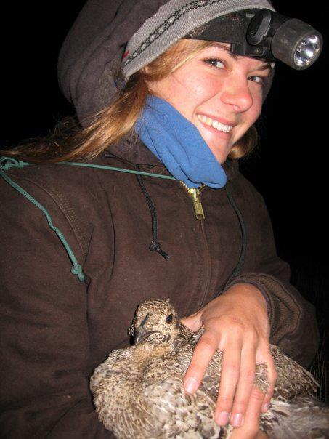
Summing it All Up
You’ve got a great bird
And a great story to tell.
Take a personal approach
to tell the big story.
Choose a landowner/partner you know well.
Plunge in and give it a try!
Feel free to ask me for help:
Contact: Deborah Richie: info@sagegrouseinitiative.com or deborahwaite.richie@gmail.com

